Slide 1





Nescafe
Coffee Sales Excellence

Slide 2

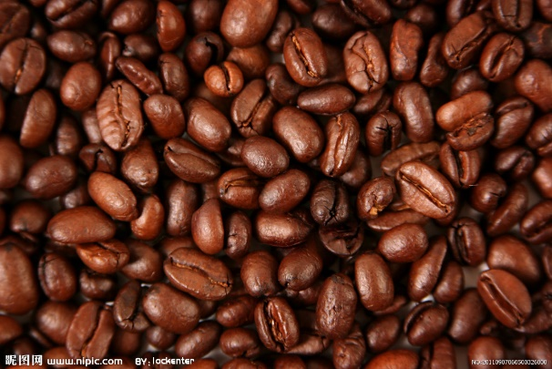
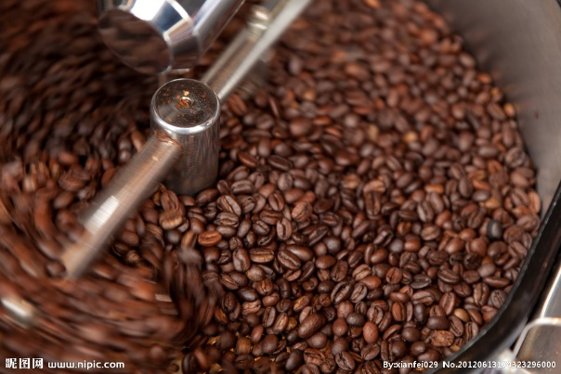



Slide 3

Why Nescafe?
0
1
Transforming retail through data-driven insights
0
2
Global leader in coffee innovation
0
3
Trusted by millions worldwide
Nescafe

Slide 4

Project Overview
BI Solution:
Tableau / Power BI
Covers products, stores & customer demand
Real-time visibility into sales operations

Slide 5

Project Context
Challenges:
Peak demand identification
Store-level profitability
Product category management
Customer loyalty improvement
Highly dynamic coffee retail environment

Slide 6
Key Business Problems
03
STEP
02
STEP
01
STEP
Weak product contribution tracking
Limited store-level visibility
No clear demand fluctuations

Slide 7
Solution Highlights
Unified dashboard (118.94K sales)
Nescafe
Nescafe
Interactive filters & heatmaps
Nescafe
Nescafe
Weekday vs weekend analysis
Store & category breakdowns

Slide 8
Objectives
一
Visualize product performance
二
Compare store contributions
三
Analyze customer behavior
四
Enable strategic sales & marketing

Slide 9
Target Audience
Add title
Leadership – Monitor growth
Category Managers – Optimize product mix
Store Managers – Staffing & inventory
Marketing Teams – Campaign targeting

Slide 10





Key Considerations
118.94K sales analyzed
Peak demand: 7–11 AM & evenings
Coffee leads (46K), Tea (33K)
Hell’s Kitchen store tops revenue
Weekdays (67%) > Weekends (33%)

Slide 11

KPIs
Top Category: Coffee – 46K
Weekday Sales: 79.59K (67%)
Total Sales: 118.94K
Top Store: Hell’s Kitchen – 40K
Weekend Sales: 39.35K (33%)

Slide 12
Key Visuals (Dashboard)
Product type sales
Category breakdown
Store performance
Hourly heatmap
Weekday vs Weekend

Slide 13
Workflow / Project Lifecycle
Workflow
Data Collection (POS, Excel/CSV)
Cleaning (null removal, standardization)
Data Modeling (star schema)
Dashboard Design (BI storytelling)
Deployment (secure access)

Slide 14
Tools & Tech Used
01
STEP
Power BI / Tableau – Dashboards
Secure Access – Deployment
02
STEP
Excel / CSV – Data source
POS Integration – Store reporting

Slide 15
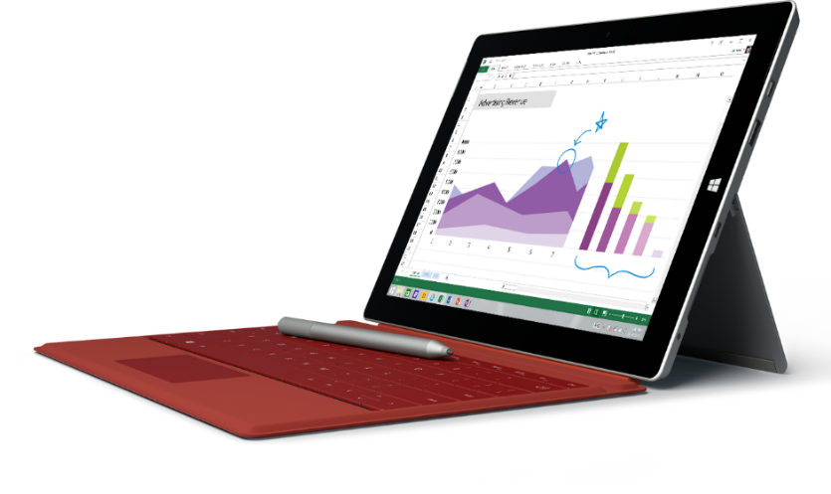
Key Insights
☕ Coffee dominates – focus on premium brews
🏢 Hell’s Kitchen = top performer
⏰ Strongest sales: Morning hours
📆 Weekdays > Weekends

Slide 16
Strategic Recommendations
1
2
PART 2
3
4
Expand Hell’s Kitchen model
Launch weekend offers
Target morning commuters
Invest in premium espresso lines

Slide 17
Future Scope
Real-time POS integration
Mobile dashboards
Predictive analytics
Customer segmentation

Slide 18


Business Impact
Better sales visibility
Smarter promotions & staffing
Improved customer engagement
Enhanced profitability

Slide 19
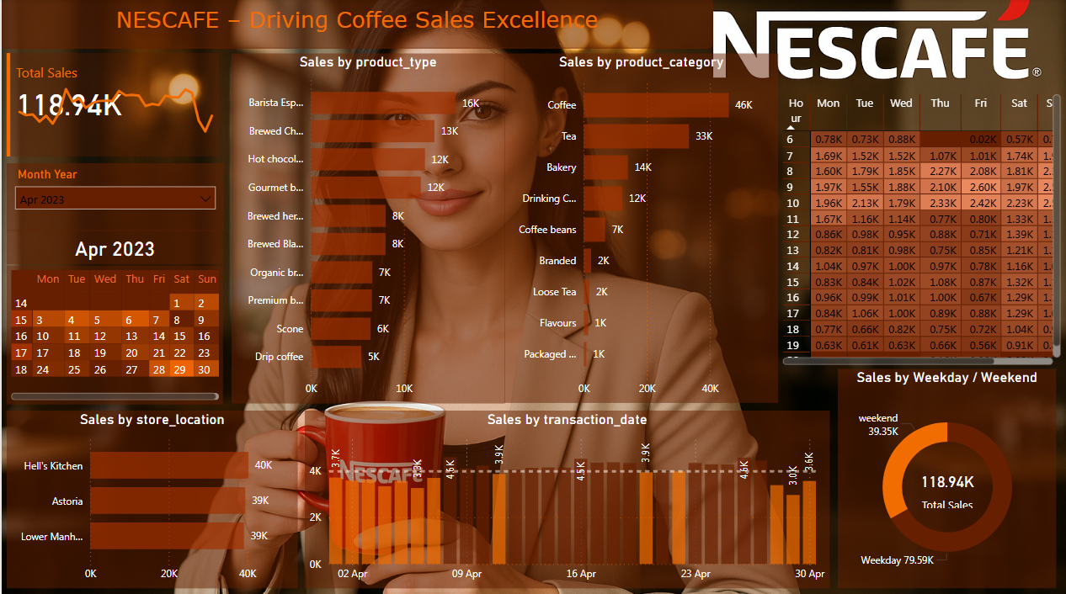
Final Dashboard

Slide 20
Project Overview

Slide 21
Thank You Nescafé,
for adding warmth, energy, and inspiration to every moment.

